Slide 1





Indian IT Sector
To:
Mayuresh Joshi Sir (Industry Mentor)
Rushit Sejpal Sir (Industry Mentor)
Dr. Neetu Yadav Ma’am ( PS-1 instructor)
Final Seminar
By: Anushka Panda – L&T Infotech
Ayushi Jain – Mindtree
Chirag Goswami – NIIT Tech
Harshit Kumar Dubey – Infosys
Sarthak Dalmia – Cyient
Shashwat Singh – TCS
As a part of PS-I project requirements of BITS Pilani, at William O’Neil, India

Slide 2
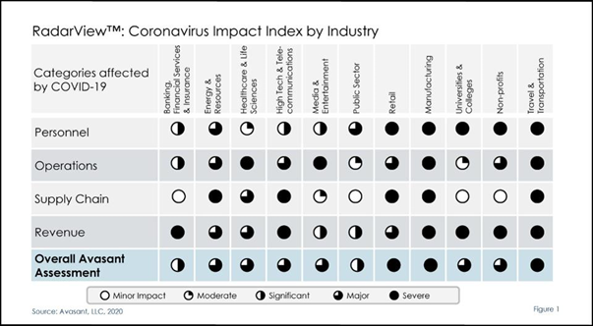
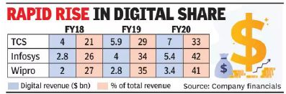
Macro-analysis
Most IT firms have their business diversified into different clients from different sectors, so, in general IT firms were not as badly hit by the Covid-19 pandemic as some of the other sectors like retail, manufacturing and travel/hospitality.
Travel and Hospitality
BFSI and retail sector
Life Sciences and Healthcare
Media and Communications
Digital sector
Manufacturing
Airlines
Major macro-economic problems faced by IT-sector
Covid-19 pandemic
Global Political and economical situation
Business model and Strategy challenges
Hiring & Litigation
Complex and changing global regulations
Data protection laws, cyber security, IP Violation
INR depreciation
Negative reputation
Overseas expansion
Most IT firms derive revenue by providing services to other companies from different sectors.
If these other sectors get affected, then so do the IT companies.

Slide 3
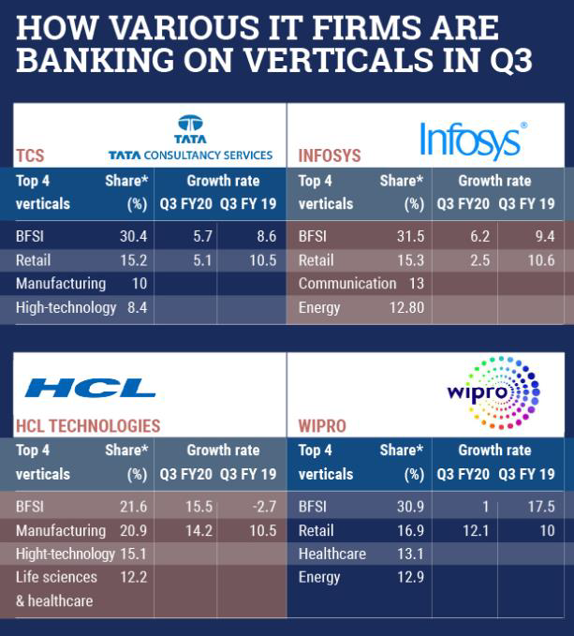
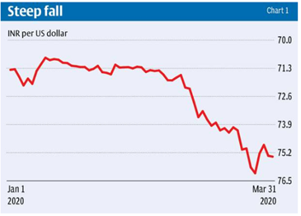
Currency Depreciation
BFSI and Retail Sector

Slide 4
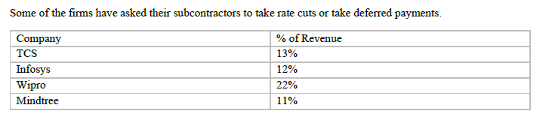
Cost Cutting Measures
Salary Capping
Work from home
Weaker Rupee
Sub-contracting

Slide 5
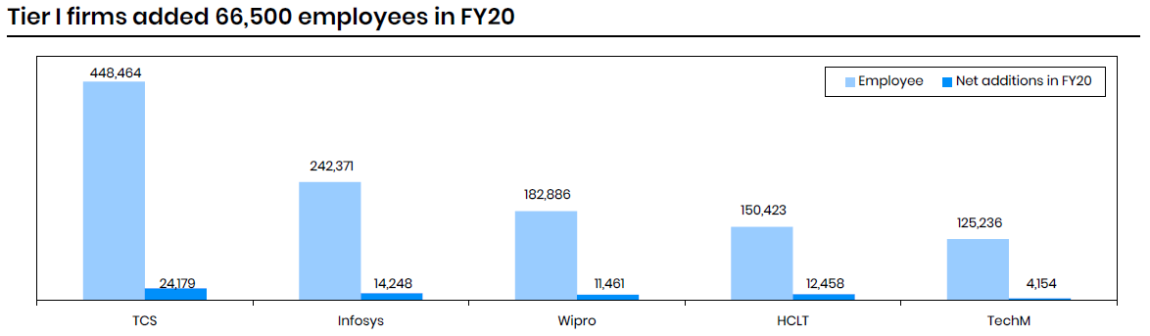
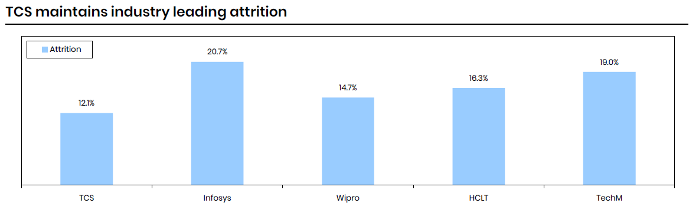
Hiring and litigation

Slide 6

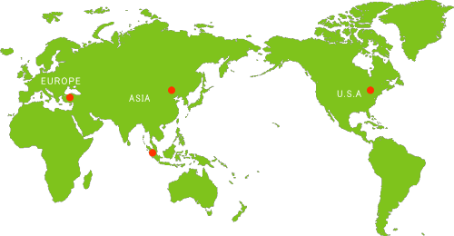
Negative Reputation Overseas expansion & Restrictions

Slide 7
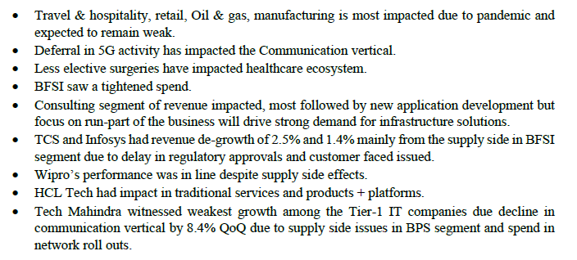
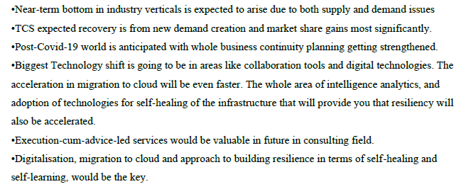
Summary

Slide 8
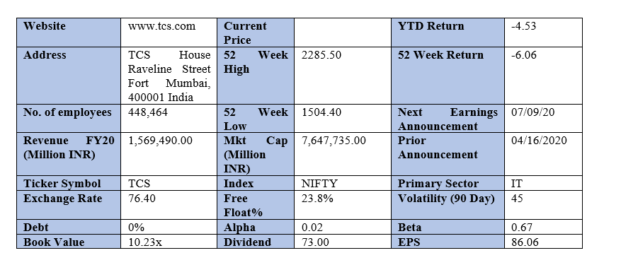
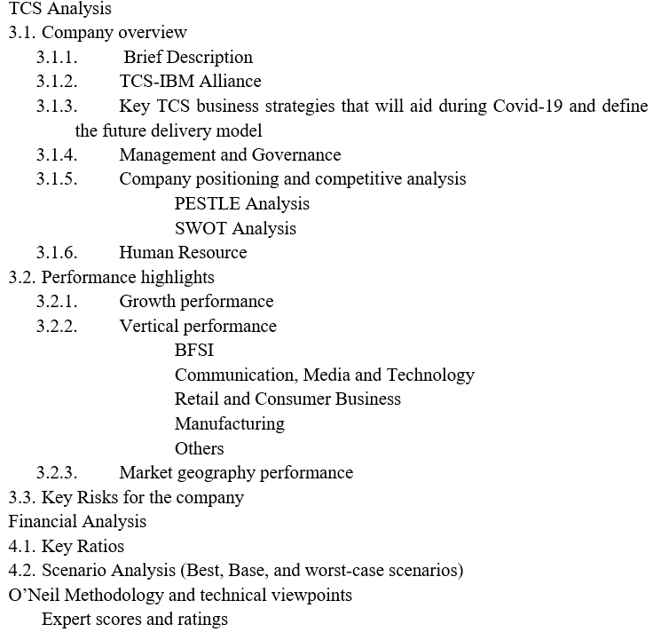
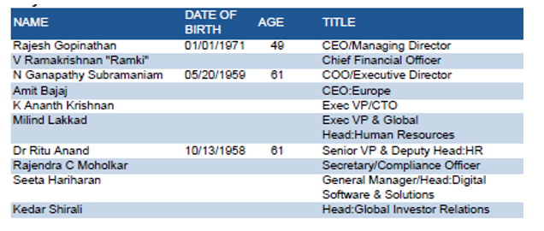

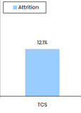
TCS
TCS’ Location Independent Agile Model
SBWS
Machine First Delivery Model

Slide 9
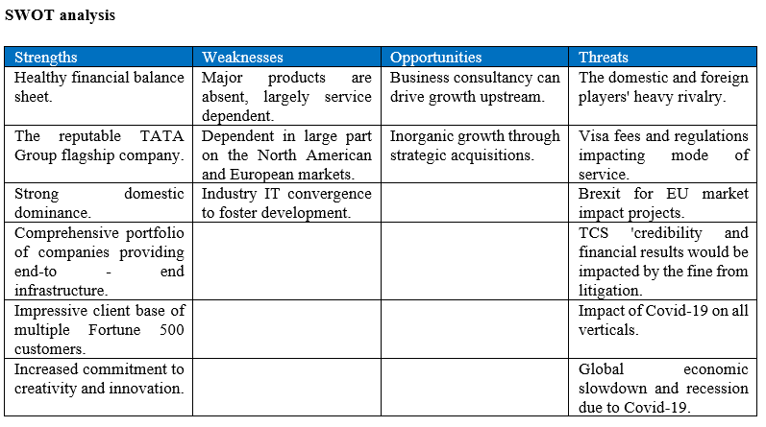
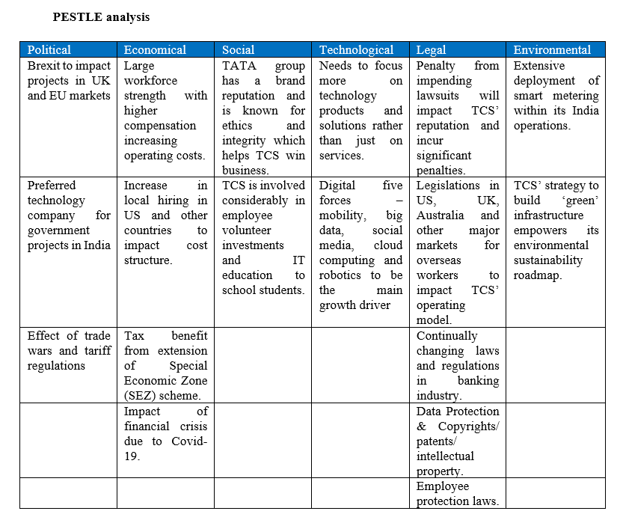

Slide 10
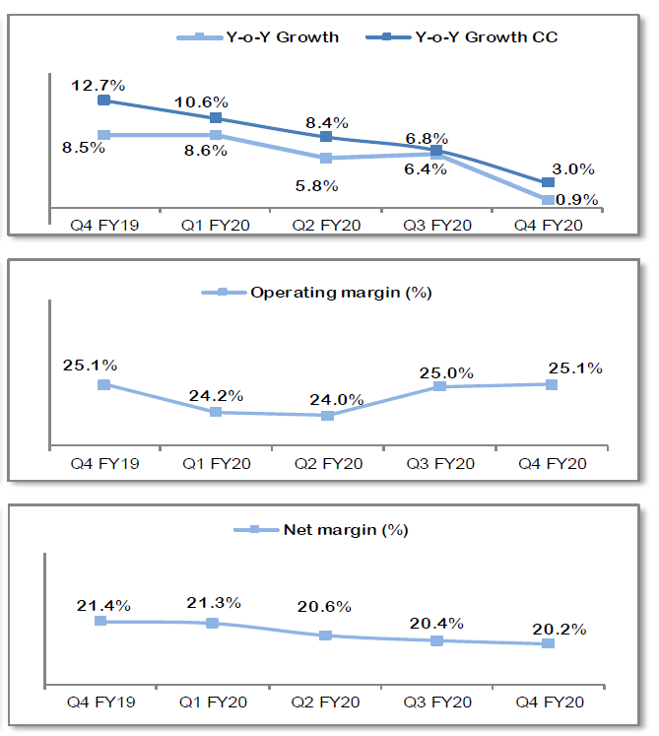
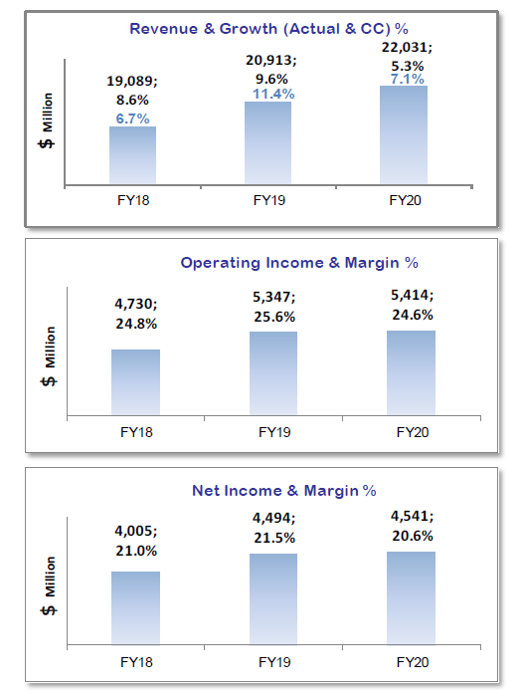
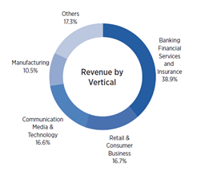
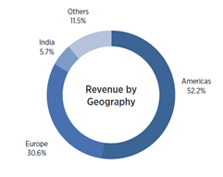
Performance Highlights
Growth Performance Vertical Performance Geographical Performance

Slide 11
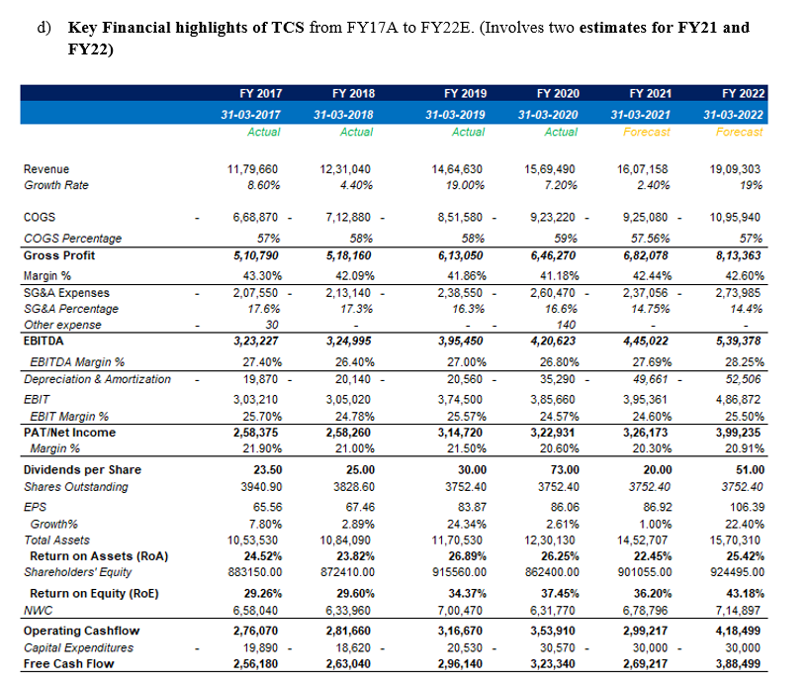
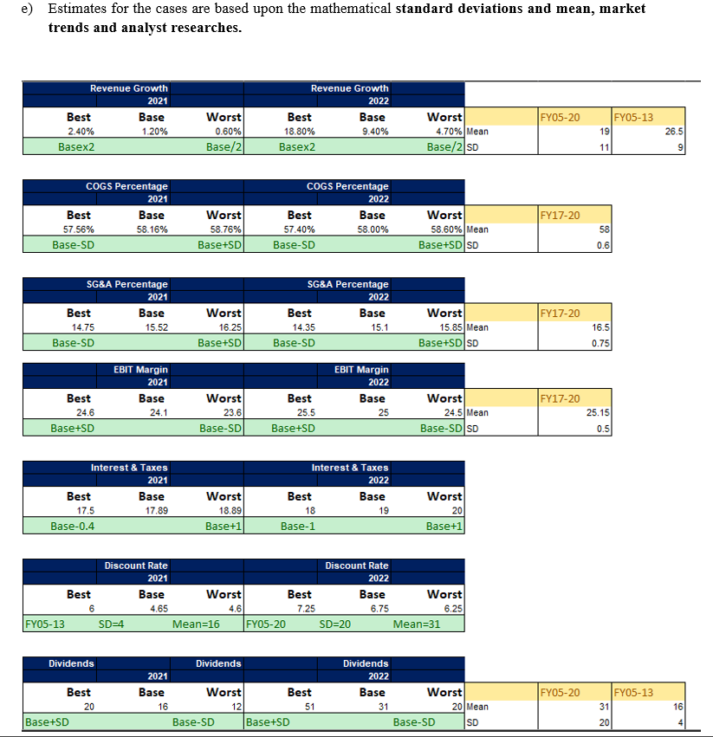
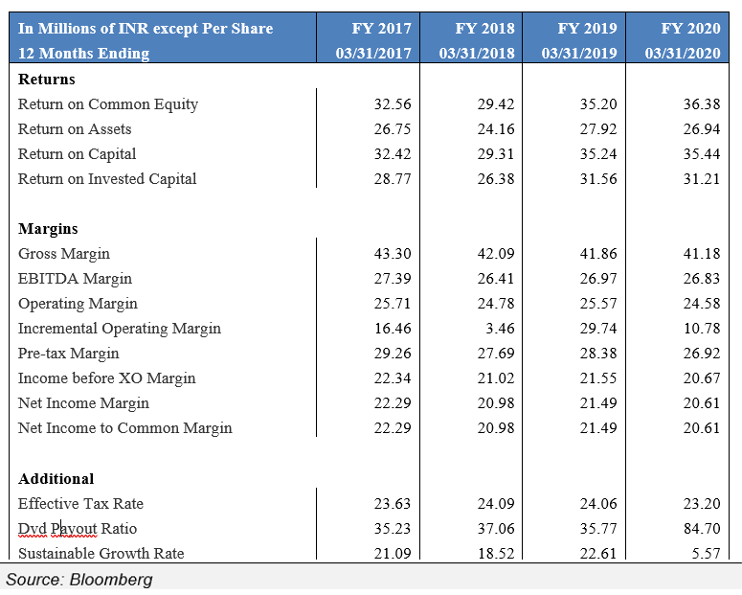
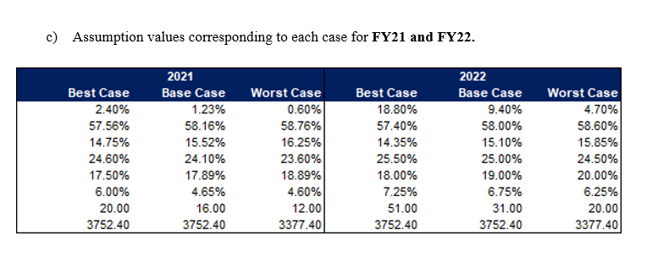
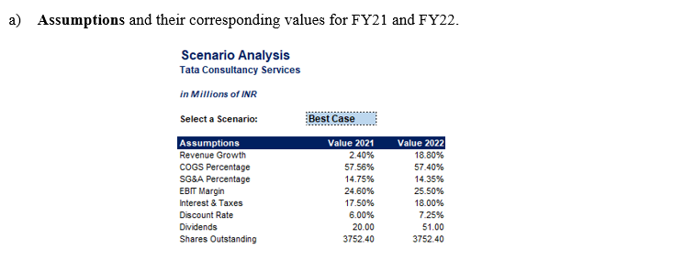
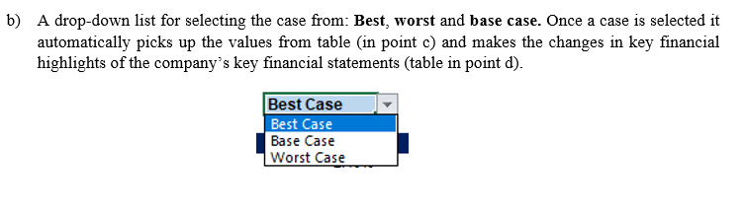
Financial Analysis
Key Ratios , followed by Scenario Analysis

Slide 12
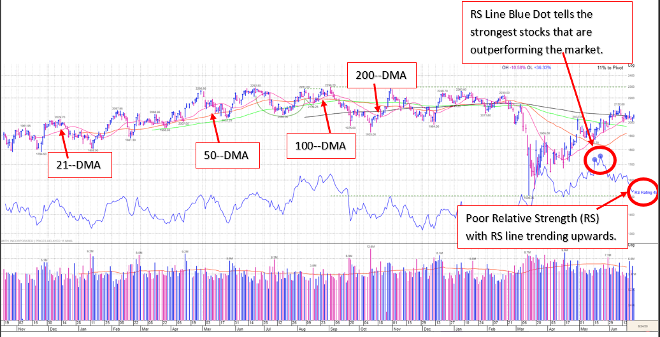
Key Risks & O’Neil Methodology and Technical Viewpoint
Covid-19 Pandemic
Global Political and economical situation
Limiting upstrick to attrition rate
Cost in employee training
Weak BFSI and retail sector
Business model and regulations/restrictions
Currency depreciation
Data protection laws, cyber security, IP violation
Brexit
Tensions with China

Slide 13
Infosys
Company Overview Infosys Limited, is an Indian multinational corporation that provides business consulting, information technology and outsourcing services. It has its headquarters in Bangalore, Karnataka, India. Infosys is the second-largest Indian IT company after Tata Consultancy Services by FY2020 revenue and 596th largest public company in the world based on revenue. On March 29, 2019, its market capitalisation was INR 3,01,483.24 Cr.
SWOT Analysis:- Strengths:
Company with no debt and extremely strong cash position with $ 3.6 bn.
Company with Zero Promoter pledge.
Increasing revenue every quarter for the past 4 quarters.
Strong cash generating ability from core business- Improving cash flow from operations for the last 2 years. For FY2020, operating cash flow grew 15.4% to $2.611 bn. Free cash grew 12.1% and crossed $2 bn for the first time.
Company able to generate Net Cash- Improving Net Cash flow for last 2 years. Cash flows are robust and our operating cash flows have increased from Rs 14,841 crore in FY19 to Rs 17,003 Crore in FY 20.
Infosys has partnered with major technology and business players in order to strengthen its services and business solutions. The company has earlier partnered with HP, IBM, Microsoft and Amazon etc. The strong partnership network allows Infosys to deliver innovative and collaborative solutions. Infosys recently partnered with IBM to help their clients migrate to cloud.

Slide 14
Weakness:
Decline in Net Profit(QoQ). Net profit in Q3 was Rs 4,457 Crore and in Q4 was Rs 4,321 Crore.
Decline in net profit with falling profit margin(QoQ).
Book Value Per Share deteriorating for the last 2 years.
Major fall in TTM Net Profit.
Infosys is one of the tech companies in India which has been a victim of the high attrition rate. Many employees leave for better career opportunities and higher education. High attrition rates affect a company's image. Infosys’s attrition rate continued to be higher than its peers and stood at 23.4%.
Infosys has concentrated operations majorly based out of America and Europe. Together, North America and Europe constitute over 80% of the company’s revenue. This makes the company susceptible to instability and uneven growth.
Opportunities:
Brokers recommended upgradation or target price in the past three months.
Positive breakout third resistance (LTP>R3).
There is a positive outlook for cloud-based solutions as the fundamental nature of computing has been changed by cloud computing. Infosys having a significant presence in the cloud computing market is set to be benefitted by the increasing demand. Post COVID-19, There would be a strong interest in looking at cloud movements and making changes in virtualization.
India is an emerging market for Infosys, it recorded over 15% growth in revenues in FY20.
Threats:
Recent broker downgrades in reco or target price.
Global economic slowdown due to COVID-19 may continue for several years – hence low IT spending globally.
Due to the rise in unemployment, US government is set to ban H1B visas temporarily.
Shrinking margins due to rising wage inflation, Rupee-dollar movement affects revenue and hence margins.
Infosys has been facing various lawsuits in different countries. Recently, a former Infosys employee has filed a lawsuit for racial discrimination.

Slide 15
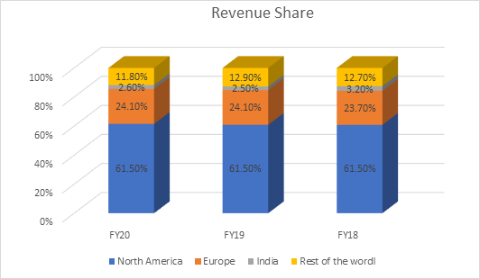
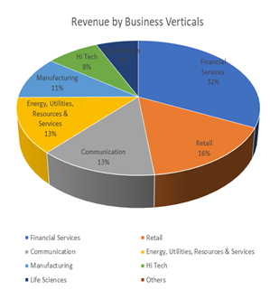
Financial Performance: FY20 was an exceptional year for Infosys with double-digit growth across all sectors. Infosys grew at 9.8% in constant currency in FY20. Although it reported -0.8% QoQ growth in constant currency in Q4. Operating margin was 21.3% in FY20 and 21.1% in Q4. Total revenue for FY20 was $12.8 bn compared to $ 11.8 bn in FY19. Infosys signed deals worth $9 bn in FY20 and worth $1.65 bn in Q4. Some of these were in the last two weeks of the quarter. Digital revenue saw the biggest jump and grew by 38% making it 42% of the total Revenue. While the core revenue shrunk by 3%. EPS grew by 8.3% in dollar terms. Yield on cash balance was 7.06% in Q4 compared to 7.77% in Q3.
Total income from operations was Rs 20,187 Cr in Q4 FY20 compared to Rs 20,064 Cr in Q3 FY20. On consolidated basis, total income from operations was Rs 23,267 Cr in Q4 FY20 compared to Rs 23,092 Cr in Q3 FY20. Five of the business segments Communication, Energy, Utility, Resources and Services, Manufacturing, High-Tech and Life Sciences recorded double-digit growth in FY2020. Both North America and Europe clocked double digit growth in constant currency. Revenue in North America grew by 11.5%, Europe by 10% and by 15.5 % in India.

Slide 16
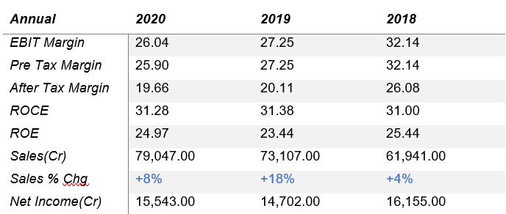
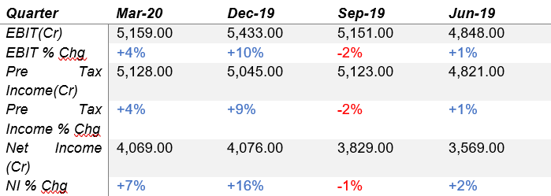

Slide 17
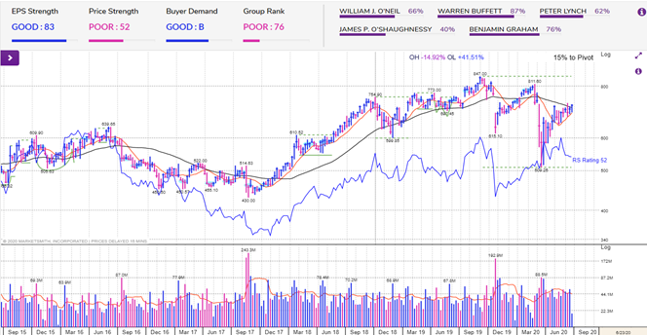
Infosys is hovering around it’s 200-Day Moving Average.
RS rating is 52 and bullish.
Decline in institutional sponsorship.
Increase in quarterly earnings for the past four quarters.
ROE for the stock stands at 25%.
Earnings Per Share Rating indicates great yearly and recent period earnings growth for Infosys.
Relative Strength Rating indicates mediocre price performance for Infosys.
Accumulation/Distribution Rating indicates that there is strong professional buying of Infosy
Industry Group Rank indicates that Infosys's industry group Computer-Tech Services has shown average price performance.

Slide 18
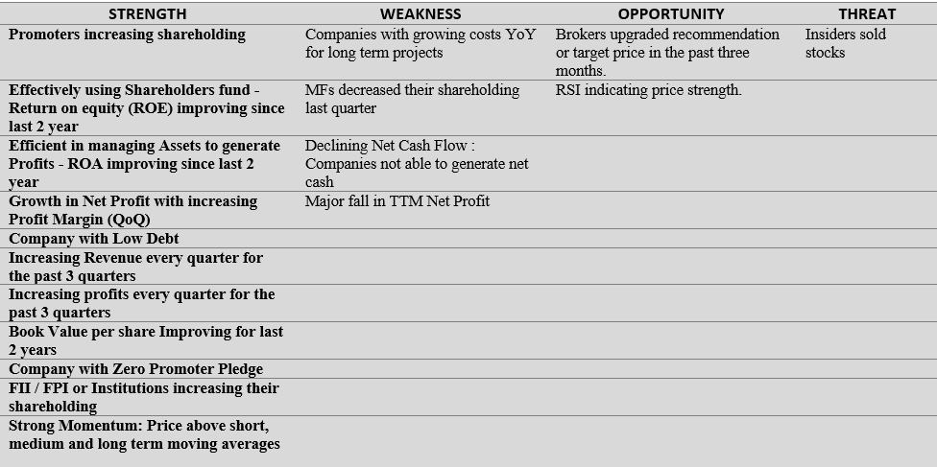
Mindtree
Company Overview
Mindtree Limited (‘Mindtree’ or ‘the Company’) is an international Information Technology consulting and implementation enterprise that provides business solutions through global software development.
The Company is consisted of four industry verticals – Retail, CPG and Manufacturing (RCM), Banking, Financial Services and Insurance (BFSI), High Technology and Media (Hi-tech) (erstwhile Technology, Media and Services-TMS) and Travel and Hospitality (TH).
The Company provides services in the areas of agile, analytics and information management, application development and maintenance, business process management, business technology consulting, cloud, digital business, independent testing, infrastructure management services, mobility, product engineering and SAP services.
SWOT analysis

Slide 19
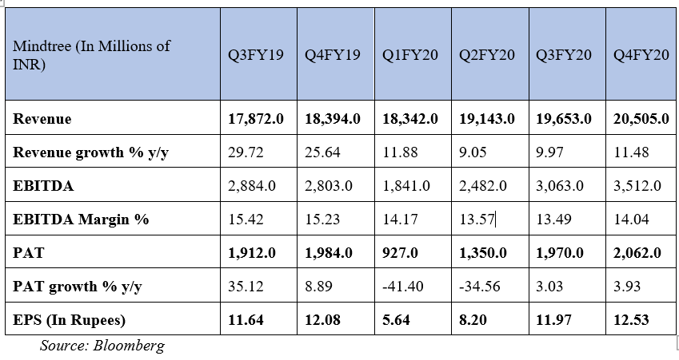
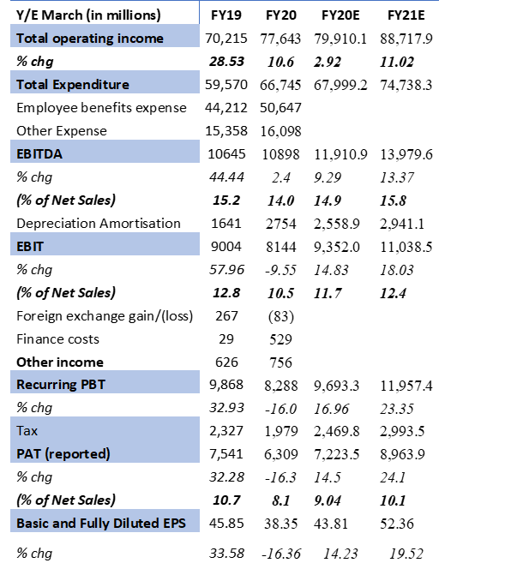
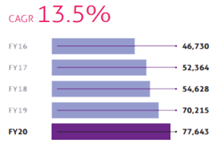
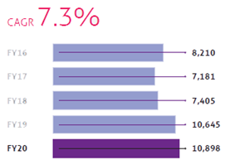
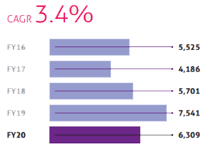
Financial Performance
Revenue
EBITDA
Net profit (PAT)

Slide 20
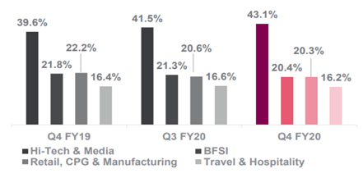
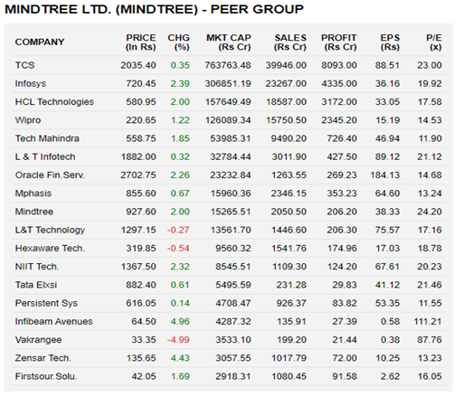
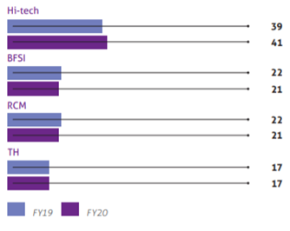
Quarterly revenue by verticals
Peer Review
Mindtree stands at the 9th position with respect to its peers with a market cap of 15,265.51 Cr.
It has an EPS of 38.33 which is low as compared to its peers which shows a comparatively lower profitability.
A high P/E ratio of 24.20 means that a stock's price is 24.2 times high relative to earnings and can be overvalued.
Stock price of 927 is high but cannot be used compare that the company's better than the others
Yearly revenue by verticals

Slide 21
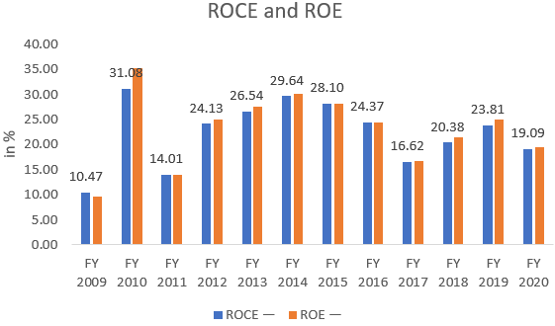
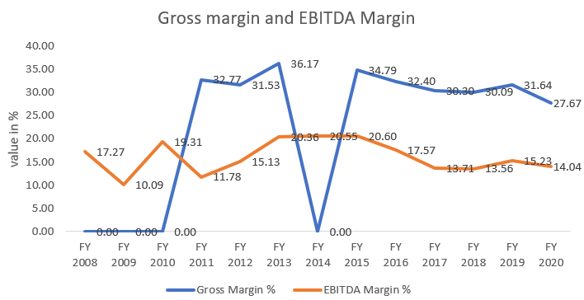
Financial Ratios
Current Valuations
At the current price of Rs 826.0,
the price to earnings (P/E) ratio of MINDTREE LTD stands at 20.5 times its trailing twelve months earnings,
Its price to book value (P/BV) ratio stands at 5.2 times.
Returns
Margins
The ROE has been constantly been higher or same as that of ROE since 2010.
Their Return on Capital Equity decreased from 24.9%in FY19 to 19.5% in FY2020.
Their Return on Capital Employed (ROCE) strongly stood at 25.3%, despite the impact of Ind AS 116
EBITDA margin decreased from 15.2% in FY19 to 14% in FY20.
Gross Margin also decreased as compared to FY19 from 31.6% to 27.7% in FY20.

Slide 22
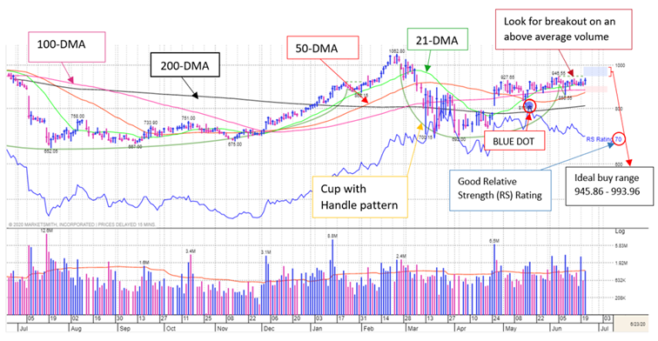
O’Neil Methodology and Technical Viewpoint:
The stock is forming a cup with handle and trading ~2% below pivot. After correcting in April 2020, the stock reclaimed its 50-DMA on April 28, 2020 and is constantly above it.
Along with an improvement in price-volume action, the Relative Strength (RS) line is having a zig zag pattern, with an RS Rating of 70.
EPS Rank of 66 reflects mediocre yearly and recent period earnings growth for Mindtree (Nse). Also, the number of funds holding the stock increased 7.83 % in FY20.
Blue Dot appeared around May 19 indicating that the stock is breaking out of the base.
Buyer Demand is A+ indicates that there is strong professional buying of Mindtree (Nse).
Industry Group Rank is 74 indicating that Mindtree (Nse)'s industry group Computer-Tech Services has shown average price performance.
We may consider adding the stock to our model portfolio if it breaks out of the base on higher–than-average volume. The ideal buy range for the stock is Rs 945.86 - 993.96.

Slide 23
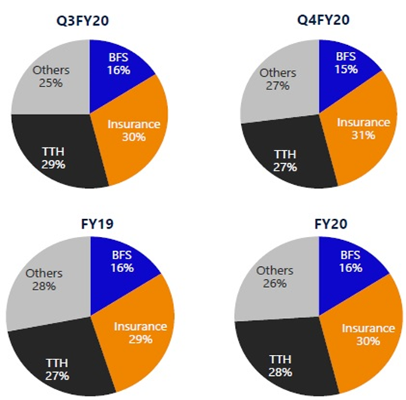
NIIT Tech
IT solutions company: focus on automation, DA, Cloud and Digital computing, and app development and management
Key sources of revenue: BFS, Insurance and Travel & Hospitality
Closed 4 large deals in Q3 and 3 in Q4 FY20
From Q3 to Q4 BFS largely remained flat, Insurance grew by 5.8% and TTH declined by 2.1%
Annually, BFS grew by 13.9%, insurance by 20.5% & TTH by 18%
The annual revenue grew by 18.5%
The digital revenue grew by 47% YoY
Markets in America have declined slightly, with EMEA remaining strong, mainly due to Whishworks and NITL revenues from EMEA. No worries depicted due to brexit.
Share buyback of 19.56 lac shares at Rs.1725 each in May 20’
Change of name to Coforge
Serious cost cutting measures, Attrition still very good at 11.75%
90% new orders came from existing clients, 27% of total revenue came from top 5 clients
Major headwinds from TTH sector in FY21 (single digit decline)

Slide 24
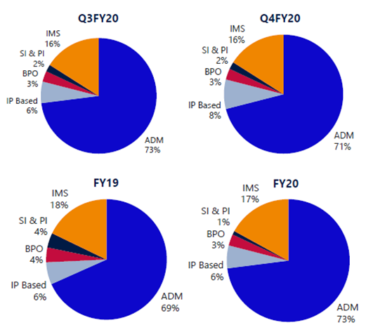
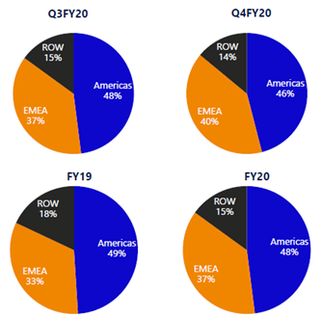

Slide 25
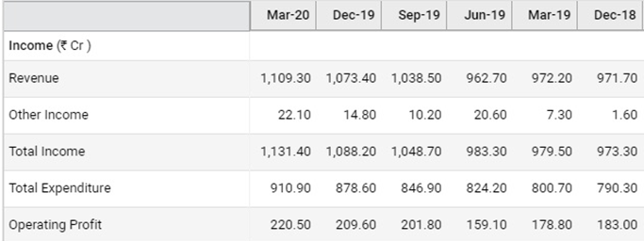
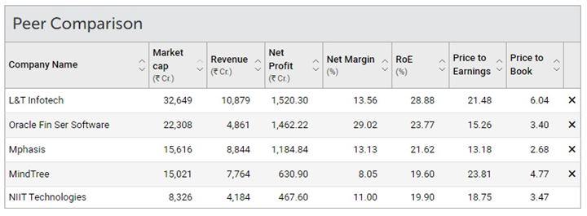
Revenue growth of 13.81% last year
3 year average at 14.30%
YoY EPS growth is above 80%
EBITDA margins were consistent at 18%, even in Q4.
5 year sales growth has been slow at 9.79%, but has improved to 11% for last 3 year average.
Amongst peers, NIIT Tech has a relatively low net margin, due to investments made in Q3, the Covid pandemic and due to lower spreading overhead due to smaller size.
Debts are virtually zero, no risk of bankruptcy.
RoE was 19.90% for the last year - good but not great. Shows operational profitability..
Current Ratio was 2.71, no major problem in repaying current debts.
Provided a healthy dividend consistently over the past 5 years.
The acquisitions of Whishworks and NITL have proved to be excellent. They were key in keeping revenues afloat in Q4.

Slide 26
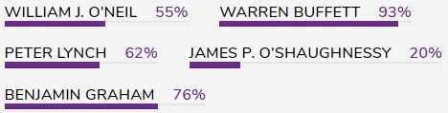
CANSLIM
Current earnings: EPS up 83% YoY
Annual Earnings: EPS growth at 26% (3 years)
New Products: Name change, share buyback
Supply/Dd: Share buyback- supply decreased
Leader/Laggard: RS rating of 58 (Weak)
Institutional Sponsorship: Promoter holding doubled
Market Trend: Confirmed uptrend, possible bull trap
Buys | 56.5% | 13
Holds | 34.8% | 8
Sell | 8.7% | 2
Bloomberg Estimates

Slide 27

MarketSmith Analysis
EPS Strength: 90 (Great)
Price Strength: 58 (Poor)
Buyer Demand:B (Good)
Group Rank: 74 (Poor)
Overall Score: C

Slide 28



L&T Infotech
Overview of the Company:
Founded in 1997, parent company is Larsen & Toubro, specializes in global technology consulting and digital services.
Ranked 6th largest IT company in India in terms of export revenue.
Major sectors include BFS, Insurance and Manufacturing.
Major work based in North america, Europe and ROW countries.
As of March 2020, net worth of the company is INR 5228 crores with zero debt.
After the global pandemic situation, the company’s focus has been to shift its working to cloud.

Slide 29

SWOT Analysis:
Strengths
Shifting workings to cloud, 100% of workforce in WFH, rising net cash flow and cash from operating activity
Zero debt, ending last three years with a strong balance sheet.
Increasing profits every quarter for the last three quarters, annual net profits improving for the last 2 years, book value per share improving for last 2 years.
Increasing revenue each quarter for the past 3 quarters.
Strong Momentum: price above 200, 100, 50 and 21 DMA.
Stock nearing 52 week high.

Slide 30



Weaknesses
Hunting for newer clients has lagged over in years in LTI, as the prime focus had been to mine strategic accounts and scale them to drive overall growth. This has resulted in a dominance of revenue and incremental growth from top customers
Promoters L&T have been linearly decreasing their shareholding in the company.
Companies with growing costs YoY for long term projects.
Opportunities

Slide 31

Stocks have formed a cup with handle pattern and is trading about 6% below pivot level.
Earnings Per Share Rating of 83 indicates great yearly and recent period earnings growth
RS rating stands at 72, implying mediocre price performance, advisable to keep stock on watchlist but not invest.
Poor group rank of 76 of 197, average price performance, lagging stock

Slide 32

Cyient
Company Overview
Cyient Limited (formerly Infotech Enterprises Limited) is focused on engineering, manufacturing, data analytics, and networks & operations. Cyient has a diversified base of over 300 customers out of which 29 are Fortune 500 companies across multiple industries including but not limited to aerospace and defense, geospatial, mining, semiconductors, communications and medical and healthcare.
SWOT Analysis:
Strengths:
Efficient in managing Assets to generate profits (ROA improving since last 2 years).
Effectively using Shareholders fund (ROE improving since last 2 years)
Book value of share increasing since last 4 years at a CAGR of 9.3%.
Company has zero Promoter Pledge.
Low debt with current ratio 2.21.
Stock gained more than 20% in one month with volume above average.

Slide 33


Weaknesses
De-growth in revenue (Q1FY21E decline 15-20% QoQ) and profit.
Decline in net profit and profit margin both QoQ and YoY.
Declining net cash flow
Major fall in TTM net profit
Declining revenue for the past two quarters.
Opportunities
Current PE(TTM) is 8.22 (less than 3 year, 5 year and 10 year averages)
Institutional buying resulted in good buyer demand.
New opportunities in semiconductors and healthcare technology with automation and higher health consciousness.
Increased defense expenditure by countries creates opportunities for expansion of an already strong A&D network.
Threats
Decline of aerospace may result in further decrease in revenue, profits, etc..
Increasing trend in Non-Core income.
Higher Capex (INR 2,149m, mainly on laptops due to work from home) resulted in weak free cash flow

Slide 34


Key Financials:
Balance Sheet
Income Statement

Slide 35

William O’Neil Methodology
Stock is still struggling to form a consolidated base.
EPS is at 57 which suggest poor earnings of the stock.
Relative Strength is 12 weak price performance.
Buyer demand is good indicating higher institutional buying. Following this it also surpassing the 21 and 50 DMA.
Current position in the stock should be to hold. Stock still needs to prove itself.
Look out breakout above average volume
Ideal Buy range
820-855.5
200-DMA
50-DMA
Poor relative strength (RS)

Slide 36
Conclusion
Despite the pandemic and global economic slowdown, cash rich Indian IT companies are poised to absorb whatever their business might take, on account of their long term relations with fortune 500 companies.Top tier IT firms such as-Wipro,TCS and Infosys have huge cash reserves, estimated at over $13 billion when put together. A drop in business may not have sudden impact on them. In terms of movement, there is a movement from the smaller or the less capable vendors to larger or the more capable vendors.
Indian IT firms were very swift in taking cost control measures including freezing lateral hiring, deferring promotions, the companies had foreseen challenges arising from revenue pressure and lower utilisations.
Sectors such as manufacturing and retail have faced severe blow due to the pandemic. Companies like Infosys, Wipro and TCS have a large share of their revenue coming from theses segments. Services which relate to areas around cloud and virtualization are actually gaining traction. Services which relate to some more project level work, which is discretionary, which will probably be slower

Slide 37
THANK YOU

